Slide 1
18CSE451T-WIRELESS SENSOR NETWORK
MINI PROJECT PRESENTATION

Slide 2
FOREST FIRE DETECTION SYSTEM.
->A forest fire detection system is a system that is designed to detect forest fires early, providing early warning to authorities and the public. The system typically consists of a network of sensors, communication systems, and monitoring centers.
->Forest fire detection is the process of identifying the presence of a fire in a forest or other vegetation-covered area.
->In recent history and even the present day, several forest fire detection methods have been implemented, such as watchtowers, satellite image processing methods, optical sensors, and digital camera-based methods.
->A network of EM500-CO2 sensors can be placed in different areas in a forest to detect when a fire has started. Besides the CO2 monitoring, which can measure the changes in temperature, humidity, and barometric pressure which are caused by a fire in the forest.

Slide 3
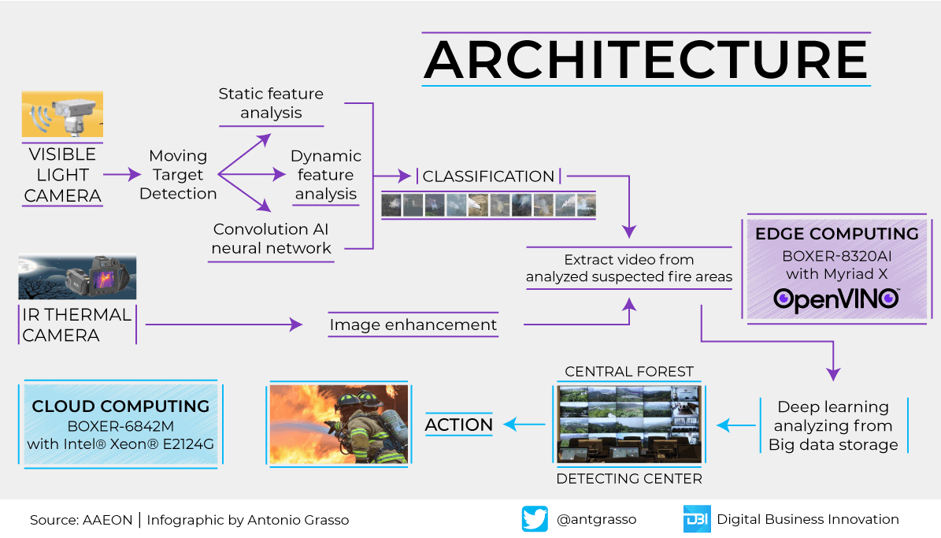

Slide 4
The detection of forest fires can be accomplished through various methods, including:
Visual detection: This involves relying on human observation to identify the presence of a fire in a forest. Fire towers or lookout stations may be used to increase visibility and detection accuracy.
Satellite detection: Satellites equipped with special sensors can detect the heat signatures of fires from space, which can help detect fires in remote areas.
Sensor-based detection: As mentioned earlier, various sensors can be used to detect forest fires based on parameters such as temperature, smoke, and flames.
Unmanned aerial vehicles (UAVs) or drones: Drones equipped with sensors can be used to detect fires in remote areas or areas that are difficult to access by ground-based methods.

Slide 5
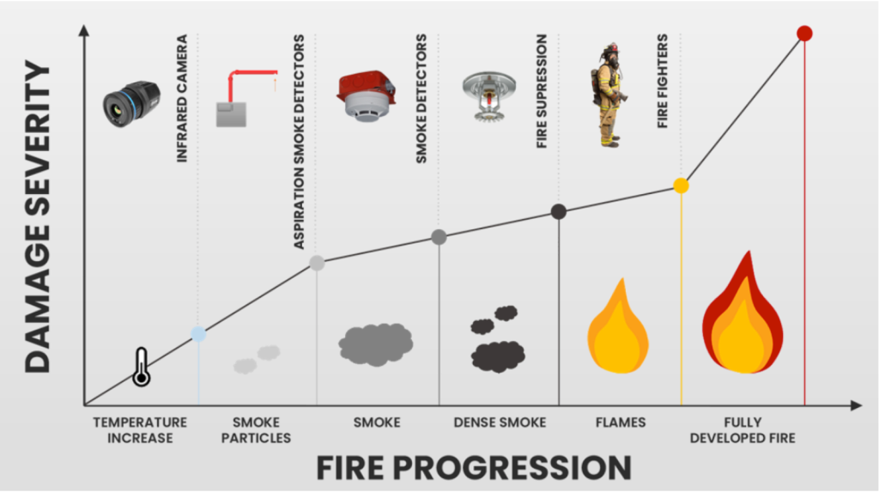

Slide 6
REQUIREMENTS:-
1.Sensors: As mentioned earlier, sensors are used to detect forest fires based on various parameters such as temperature, smoke, infrared radiation, gas, and flames. The sensors can be deployed on the ground, on towers, or on drones, depending on the terrain and the coverage required.
2.Communication systems: Once a fire is detected, the system needs to transmit an alert to authorities and firefighters quickly. This is typically done through a communication system that can include radio, satellite, or cellular networks.

Slide 7
3.Monitoring center: The monitoring center is responsible for receiving alerts from the sensors, analyzing the data, and dispatching firefighters to the location of the fire. The monitoring center can also provide real-time updates to the authorities and the public.
4.Firefighting equipment: The system can also include firefighting equipment such as fire trucks, helicopters, and water pumps to help manage and control the fire.
5.Data analysis: The system can also collect and analyze data to help authorities make informed decisions about managing the fire. For example, the system can track the movement of the fire and predict its trajectory, helping authorities determine the best course of action.

Slide 8
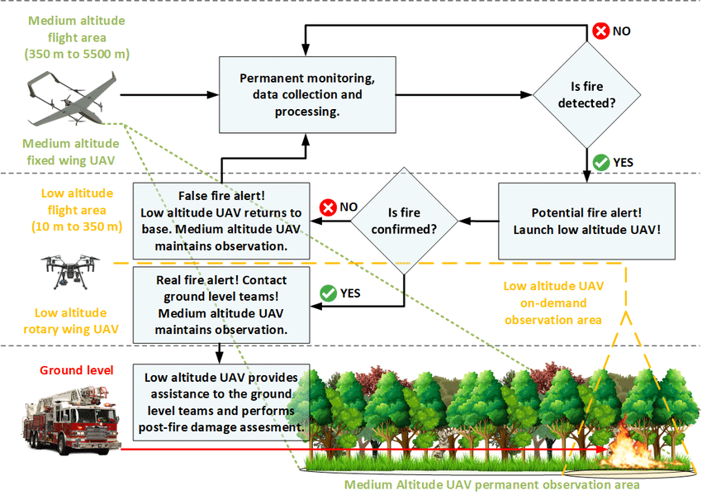

Slide 9
VARIOUS METHODS FOR DETECTION:-
1.Remote sensing: This involves using satellites and aerial sensors to monitor forest areas for signs of smoke, heat, or changes in vegetation patterns that could indicate a fire. Remote sensing can cover large areas and provide early warning of potential fires.
2.Automated systems: These systems use sensors and cameras to detect heat and smoke in real-time. They can be installed on towers, drones, or other platforms and can quickly alert authorities to the location of a fire.

Slide 10
3.Human observation: This involves trained personnel monitoring forest areas for signs of smoke or fire. This method can be effective but is limited by the number of personnel available and their ability to cover large areas.
4.Citizen reporting: This involves members of the public reporting potential fires to authorities through phone hotlines or mobile applications. This method can be helpful in areas where there are not enough trained personnel to monitor the entire forest.

Slide 11
TYPES OF SENSORS INVOLVED:-
1.Infrared sensors: These sensors detect infrared radiation emitted by a fire, and can be used to detect forest fires from a distance. They are often used in combination with cameras to provide visual confirmation of the fire.
2.Smoke sensors: These sensors detect smoke particles in the air and can be used to detect forest fires in their early stages, even before flames are visible.

Slide 12
3.Heat sensors: These sensors detect changes in temperature and can be used to detect forest fires based on the increase in temperature caused by the fire.
4.Gas sensors: These sensors detect the presence of gases such as carbon monoxide and methane, which can be produced by forest fires. They can be used to detect forest fires in areas where other sensors may not be effective.

Slide 13
5.Flame sensors: These sensors detect the presence of flames and can be used to provide visual confirmation of a fire. They are often used in combination with other sensors to provide a more complete picture of the fire.
6.Weather sensors: These sensors detect weather conditions such as temperature, humidity, and wind speed, which can impact the spread of forest fires. They can be used to provide additional information to authorities and firefighters to help manage and control the fire.

Slide 14
WHY IT’S REQUIRED?
.Fire detection systems are designed to discover fires early in their development when time will still be available for the safe evacuation of occupants.
.Early detection also plays a significant role in protecting the safety of emergency response personnel.
.Property loss can be reduced and downtime for the operation minimized through early detection because control efforts are started while the fire is still small.
.Most alarm systems provide information to emergency responders on the location of the fire, speeding the process of fire control.

Slide 15
.Environmental protection: Forest fires can have a devastating impact on the environment, including the destruction of wildlife habitats and the release of greenhouse gases. Early detection through forest fire alarms can help minimize the environmental impact of fires and promote recovery efforts.
.Economic benefits: The cost of fighting forest fires can be significant, and early detection through forest fire alarms can help reduce these costs by allowing firefighting efforts to begin earlier and preventing fires from spreading to more costly areas.

Slide 16
LIMITATIONS:-
1.False alarms: The alarm may be triggered by sources other than a forest fire, such as dust, fog, or insects. False alarms can cause unnecessary panic and divert resources away from actual emergencies.
2.Limited coverage: Forest fire alarms are typically limited in their coverage area, and may not be able to detect fires in remote or hard-to-reach areas. This is especially true for ground-based systems, which may not be able to detect fires on elevated terrain.

Slide 17
3.Maintenance: Forest fire alarms require regular maintenance to ensure that they are functioning correctly. Failure to maintain the system can lead to malfunctions and false alarms.
4.Weather conditions: Adverse weather conditions such as heavy rain, snow, or high winds can interfere with the detection of forest fires.
5.Cost: Implementing and maintaining forest fire alarms can be expensive, and may not be feasible for all areas.

Slide 18
FUTURE ASPECTS:-
WE KNOW THAT RIGHT NOW WE CAN’T DIRECTLY CONTROL THE FIRE BY JUST RELYING ON THE DETECTION SYSTEM COMPRISING OF SENSORS AND EQUIPMENTS. ALSO THERE ARE SOME MAJOR LIMITATIONS INVOLVED IN THIS FOREST FIRE DETECTION SYSTEM THAT WE CAN’T IGNORE.
WE CAN WORK ON SOME MAJOR DRAWBACKS RELATED TO THIS FIRE DETECTION SYSTEM SUCH AS-:
ACCURACY
ENHANCED EFFICIENCY
IMPROVED POWER SUPPLY
PERSISTENCE AND CONTINUATION
MORE NO. OF AUTONOMOUS DRONES

Slide 19
1.Advanced Sensor Technologies: With advancements in sensor technologies, forest fire detection systems can become more sophisticated and efficient. We can expect to see the development of more advanced sensors that can detect the smallest of smoke particles and differentiate between different types of smoke.
2.Machine Learning and Artificial Intelligence: The use of machine learning and artificial intelligence can improve the accuracy and speed of forest fire detection systems. These technologies can help analyze data collected from sensors and provide real-time information about the fire's location, intensity, and direction
3.Integration with Disaster Management Systems: Forest fire detection systems can be integrated with disaster management systems to provide better emergency response. This integration can help in evacuating people from affected areas, allocating resources, and coordinating rescue efforts.

Slide 20
THANKYOU

